Slide 2
A Loving People
A Righteous People
A Unified People

Slide 3
A Unified People
Philippians 1:27-28 Only conduct yourselves in a manner worthy of the gospel of Christ, so that whether I come and see you or remain absent, I will hear of you that you are standing firm in one spirit, with one mind striving together for the faith of the gospel; 28 in no way alarmed by your opponents which is a sign of destruction for them, but of salvation for you, and that too, from God.

Slide 4
A Unified People

Slide 5
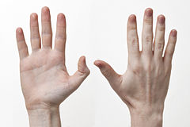
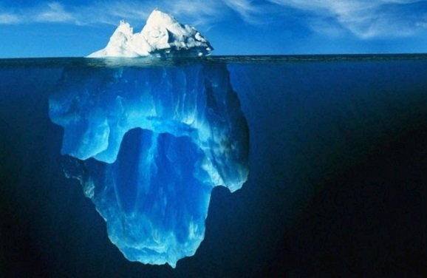
Attention
Action
Attitude

Slide 6
Attention
A Unified People
1 Corinthians 1:10 Now I exhort you, brethren, by the name of our Lord Jesus Christ, that you all agree and that there be no divisions among you, but that you be made complete in the same mind and in the same judgment.

Slide 7
Action
A Unified People
Romans 12:16 Be of the same mind toward one another; do not be haughty in mind, but associate with the lowly. Do not be wise in your own estimation.

Slide 8
Action
A Unified People
2 Peter 1:20-21 But know this first of all, that no prophecy of Scripture is a matter of one's own interpretation, 21 for no prophecy was ever made by an act of human will, but men moved by the Holy Spirit spoke from God.

Slide 9
Attitude
A Unified People
John 17:11 I am no longer in the world; and yet they themselves are in the world, and I come to You. Holy Father, keep them in Your name, the name which You have given Me, that they may be one even as We are.

Slide 10
Attitude
A Unified People
John 17:20-23

